Slide 1
AMI 1.2 Product: Technical Overview
02/24/2016

Slide 2
Outline
Architecture Overview
AMI 1.2 Features
Power Outage: Detection and Reporting
OTA Protocol: Transport, Reliability, QoS (uStream/MTP)
OTA Meter Program Update
EMCM (AMI Module) FW upgrade
Areas of Concerns
Questions/Answers

Slide 3
Architecture Overview

Slide 4















Customer Facing System View
RPMA Total View Appliance or Hosted Service
Ingenu Total View
Network Controller
3rd Party Software
CIS
Gateway Communications Controller
Ingenu Software
AMI Protocol &
Device Management
Communications Controller
User Billing
Distribution Automation Protocol & Device Management
MDMS
Protocol Adapters (CIM, Multispeak, DNP3)
File Export (CMEP, CSV,…)
REST API
Security Management
Services
Customer Back Office
RPMA Access Points
OMS/
DMS
Digital Oilfield Protocol &
Device Management
SCADA
Network
Database
Services
Device Database
Services
Data Historian
SNMP
Agent
EMS
SNMP
Network Management Services

Slide 5
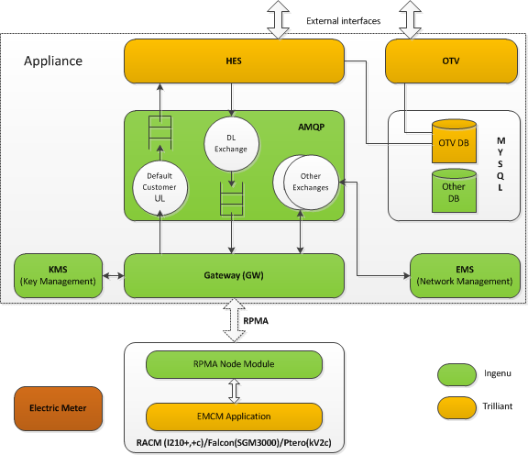
Service and Endpoint Ecosystems

Slide 6
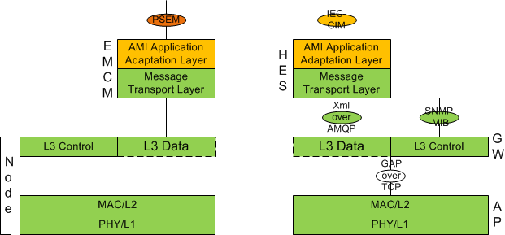
Protocol Architecture

Slide 7
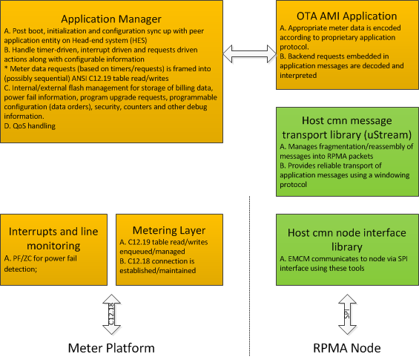
AMI Module (EMCM) FW Architecture

Slide 8
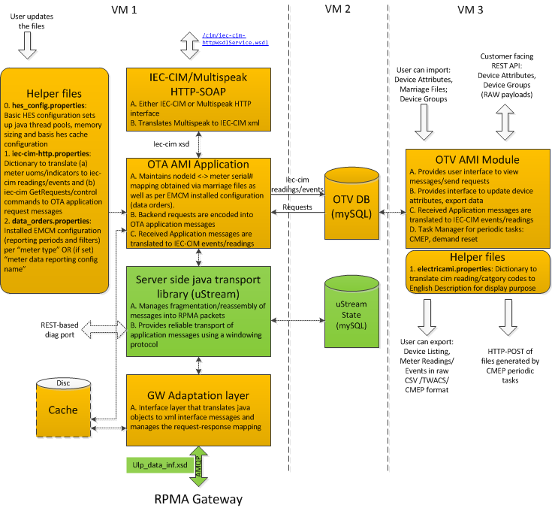
HES-OTV SW Architecture (AMI only)

Slide 9
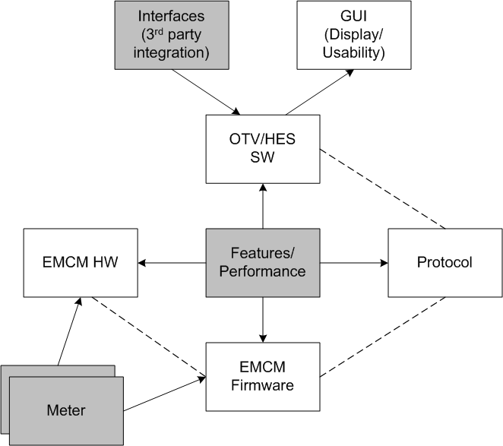
AMI Features

Slide 10
Design Principles
Good application development practice on RPMA:
Avoid periodic polling via a downlink (DL) request
Instead configure device to report periodic data autonomously
Why?: Since RPMA is designed for high coverage, link is asymmetric: uplink (UL) capacity is much higher than downlink (DL) capacity
Randomize transmission of periodic data to prevent rx spikes
Over-the-air (OTA) AMI Application Protocol (with exception of non C12.19 complaint I210+) is agnostic to meter platform
Meter-specific discrimination is done at EMCM that transforms relevant meter data into a unified AMI application protocol
Rationale: Requires minimum changes on backend SW to bring up new meter platforms

Slide 11
Feature List
Bootstrapping*: Data Order Configuration Install
Meter Readings:
Scheduled and on-demand Billing Data Read/Report
Scheduled and on-demand Load Profile Read/Report
Scheduled and on-demand “Power Quality” Read/Report
Events:
EMCM Status Events
Meter Status Events
logged Meter Events

Slide 12
Feature List (continued)
End Device Control
EMCM Soft/Hard Reset
Remote Connect/Disconnect
Load Control
DLP/ECP/PPM enable/disable (I210+c)
Load Control Override Disable (SGM3000)
Demand Reset (Immediate/Scheduled)
RTP/CPP Enable/Disable
Season Change
Clear Meter Flags* (Status Indicators)
Debug/Reconfig*: Available OTA only via HES Debug port:
EMCM Panic Block Request/Response
Get and/or update factory installed EMCM configuration

Slide 13
Data Orders
Data Orders (/opt/onramp_apps/hes/instance_1/data_orders.properties)
Generic installable configuration for a group of meters
Meters with same “Data Report Config Name” (OTV: Devices->Properties) are associated with same data order
If the attribute is not assigned, default data orders for each meterType is used
What can be configured?
Read/Report Periods of billing data, LP, power quality data
Poll Periods of meter indications and power quality events
Filters that can be used to restrict desired quantities
DST configuration
Mainly for GE meters in “demand only” mode as they don’t have notion of time
Additional stuff with defaults in EMCM → not changed for most part!

Slide 14
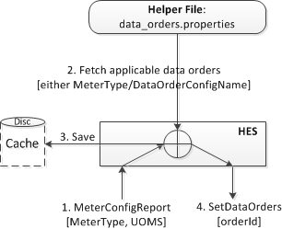
Bootstrapping: Data Orders
Installed configuration is dependent on
Meter metrology configuration (UOMs) retrieved from ST12-16, ST21-22 and ST61-62
Metrology configuration is reported by EMCM in “MeterConfigReport”. An AES-128 hash over this information (meterDataReportHash) is used to keep HES and EMCM in sync with regards to metrology information
This makes AMI solution agnostic to changes in meter program as the hash changes lead to boot process whereby HES and EMCM sync up → Design Philosophy 3
Installed configuration is identified by orderId
Stored persistently in both HES and EMCM. HES keeps a history of 1
orderId (32-bit unix timestamp) is included in billing/interval report to uniquely identify configuration. → Avoids periodic tx of config information

Slide 15
UOM -> CIM
32-bit ANSI UOM: Unit of Measure
Defined in ANSI C12.19 in ST12
Called “Measurement Profile” in GE meters and configurable via MeterMate
A wide universe of possibilities
That can be further expanded by meter vendor by setting NFS bit!
CIM: Common Information Model
Ingenu AMI solution complies with IEC-61968-9 edition 1.0
ReadingType (Annex C) is a 9 digit code
iec-cim-http.properties
Dictionary file to translate uoms → cims (meter dependent!)
Eg: meter.model.I210PLUSC.context.tou_summation.uom_hex_code.0x00024000=0.0.9.1.0.12.3.<tier>.0.0.72

Slide 16
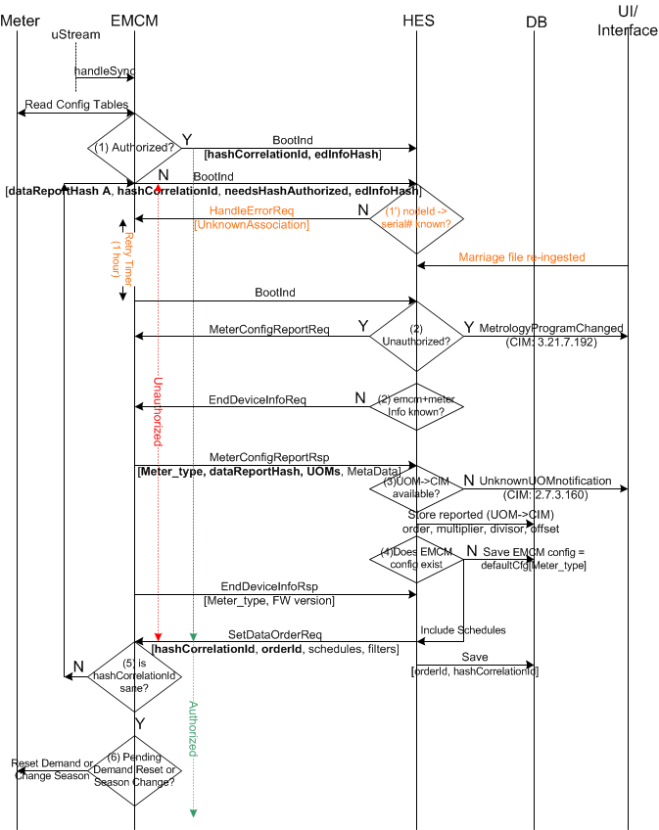
Bootstrapping
Call flow described in AMI HLD
Take away:
Adapts to meter configuration (program): Metrology configuration change makes EMCM “unauthorized” till it does a successful boot syncs with HES
Reduced overhead once synced: Post sync, a single BootInd message from EMCM->HES
Hot swapping: For SGM3000 meters, “Meter Serial Number” reported in BootInd is verified against that reported via marriage file
EndDeviceInfo is other meter info
Displayed in OTV under Device-> Properties

Slide 17
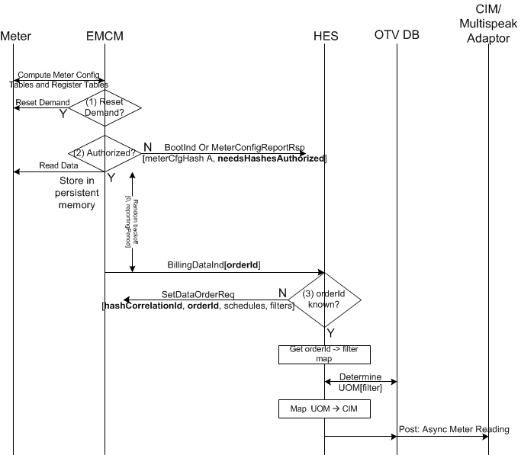
Scheduled Billing Report
Two periodic BillingDataInd possible:
BillingOrder 1: All billing data in ST 23: Summations/Demands/Coincidents/TOU
Stored in EMCM’s internal flash before transmission: Expected read period once every 24 hours
History of 2 reports stored in flash
BillingOrder 2: Only summations of total tier recorded in ST23
Read and kept in RAM till enqueued for tx
Enables frequent reporting: energy only metering
ReportingPeriod:
Tx is randomized between [0, reportingPeriod]
Retried readPeriod/reportingPeriod
Only if not successfully enqueued to transport layer

Slide 18
Scheduled Load Profile
Similar to scheduled Billing Report
Metrology configuration is checked for potential change prior to read
Maximum of 4 periodic LoadProfileInd
Corresponds to 4 LP sets recorded in ST63-67
Each report has its own reportingPeriod
Reporting Period:
readPeriod is irrelevant as persistent storage is provided by meter
Average number of “intervals” per report = reportPeriod/interval[ST61]
EMCM memory limitation: Maximum of 16 intervals per report

Slide 19
Scheduled Power Quality Reports
What is power quality report?
Instantaneous (rms) values of quantities at time of read
GE meters don’t use ST28, data is available in manufacturing tables
MT110 in kV2c and MT113 in I210+c and SGM3000
AMI 1.2 application protocol specifies following “polyphase” quantities as power quality:
LtoL Voltage Magnitude, LtoN Voltage Magnitude, Current Magnitude, Momentary PF, Average PF, ITHD, VTHD, TDD, Distortion PF, Temperature, Frequency, Active Power, Reactive Power Distortion VA, Apparent VA
Quantities reported dependent on what the meter records and data order filtering
Only kV2c 3-phase currently records all quantities
Reported periodically every reportingPeriod
Not aligned to midnight but randomly in between [0, reportingPeriod)

Slide 20
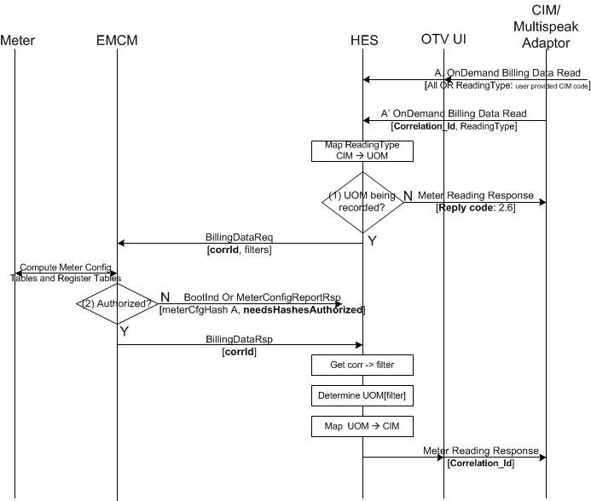
On demand Billing Report
On-demand retrieval of data in ST23
Flexible BillingDataReq OTA
BillingDataOrder can be used to request specific quantities of interest
Via IEC-CIM/UI, 4 options are provided:
All data as per installed “data orders”
All summation quantities in total tier
Only WH summation quantities in total tier
Only a specific summation in total tier
→ (b),(c),(d) are reduced latency options
GetReadings are mapped to OTA request as per iec-cim-http.properties:
0.0.1.0.0.0.0.0.0.0.72=BillingDataReq.summationsFilterMask_*.*.1.*.*.*.*.*.*.*.72.tiersFilter_0x0

Slide 21
On demand Load Profile Report
To request interval data stored in ST63 (Set 0) to ST67 (Set 3)
LP set has to specified
Time range has to specified: Time range can’t exceed 16 intervals
Otherwise HES rejects the LP request

Slide 22
On demand Power Quality Report
Reporting instantaneous quantities as per demand
Data stored in MT110 (kV2c) and MT113 (I210+c/SGM3000)
Flexible PowerQualityReportReq OTA
Request any subset of quantities protocol defines
Via IEC-CIM/UI, 4 options are provided:
All quantities recorded by the meter
Line-side diagnostics
Instantaneous demand
Instantaneous Distortion
→ What gets reported is decided by iec-cim-http.properties
eg. 12.0.0.0.0.47.0.0.0.0.0=PowerQualityReportReq.selectFlags_0x21e8.selectFlags2_0x0

Slide 23
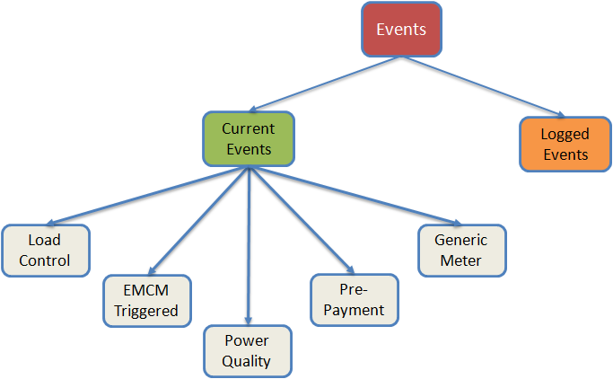
Events
Two main kinds:
Current Events:
AppEvents i.e. EMCM events
Meter Events
EMCM polls for status indicators recorded by meter. A change in state from previously polled copy in memory is reported
Poll rate is set by data order (default 5 mins)
Reported in MeterInd OTA
Logged Events: Only logged power quantity events are reported
Events logged with exact timestamp
Logged events polled at rate set by power quality event reportingPeriod (20 mins) and reported in PowerQualityEventInd

Slide 24
Current Events
EMCM current events mapped to IEC-CIM:
Defined in iec-cim-http.properties as AppEvent
Meter Current Events reported in MeterInd:
RCDC Switch State: ST112
Generic Meter Status (ST3): stdStatus1 (C12.19), mfgStatus
Events relating to line-side diag, load control, switch state etc: extraMfg
MT 72 (I210+c, kV2c) for line-side diagnostics
MT115 (I210+c) for load control/switch/PPM states
MT124 (SGM3000) for load control/switch/PPM states
MT85 (I210+c, kV2c, SGM3000) for RTP/CPP state
Mapped in iec-cim-http.properties:
Eg. meter.model.I210PlusC.context.extraMfg.flags.33.set=3.15.16.238.1
Note: Not all status indicators are mapped in properties file (maybe reported OTA)

Slide 25
Logged Power Quality Events
Events defined as power quality events in AMI 1.2 protocol:
Sag/Swell: Logged in MT112 (I210+c, kV2c), MT114 (SGM3000)
Voltage Imbalance: Logged in MT114 (SGM3000)
Under Frequency/Over Frequency: Logged in MT114 (SGM3000)
Momentary Outage: Logged by EMCM in its internal flash after outage detection
Only details of one momentary outage event is logged, count indicates if multiple events happen between poll
AMI 1.2 application does not retrieve/parse logged events in ST72 periodically

Slide 26
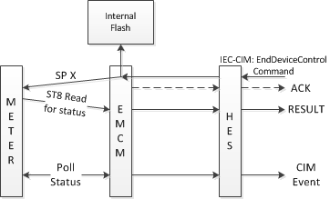
EndDeviceControl Commands:
Two kinds:
Immediate
Executed by EMCM immediately
All commands
Connect/Disconnect is immediate only
Scheduled
Stored by EMCM in internal flash
Timer set for execution
Executed at scheduled time
RTP/CPP on/off
Season Change
Demand Reset
On IEC-CIM, “category type” denotes command

Slide 27
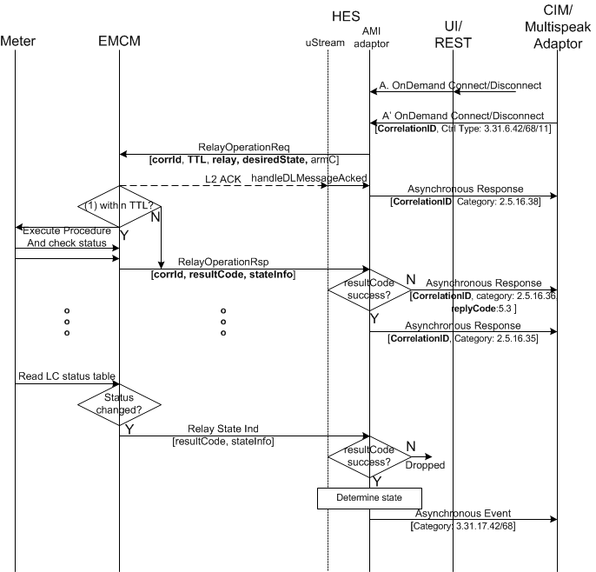
RCDC
Connect/Disconnect and DisableOverride (SGM only)
TTL of 1 hour is default at HES
Configurable
Translated to end time (POSIX) in OTA message
If requested is received after end time, EMCM drops the request

Slide 28
Demand Reset
Meter calendar driven demand reset is NOT recommended
Race condition with EMCM read of ST23 for demand data
Two ways to set Demand Reset:
Configure via Data Orders:
Set Daily Demand Reset/Month Demand Reset
Issue: Utilities don’t use fixed billing periods
Command EMCM to execute Demand Reset (immediate/scheduled)
Immediate demand reset is executed immediately
Scheduled demand reset is executed by EMCM right after billing data read (order 1) if it falls between startTime and endTime of scheduled command
OTV provides a task manager to set DemandResetReq before the end of billing cycle

Slide 29
Load Control: Meter Differences
In 120+c: Load control points (ECP/DLP/PPM/Lockout) are mapped as auxiliary relays
Enable/Disable them with RCDC command
0: Main relay; 1: ECP, 2: DLP; 3: PPM; 4: Lockout
Required as RCDC command to main relay automatically disables these load control points!
In SGM3000 meters, enabling/disabling of load control points is via meter program
However RCDC command to main relay temporarily “overrides” other controls
It is required to “Disable Override”

Slide 30
Power Outage
Detection and Reporting

Slide 31
Power Outage Detection and Reporting
Varied Requirements:
High reliability of reporting sustained outages
RPMA network star topology provides inherent advantage here
Eliminate false alarm: reporting momentary as sustained outage
Low Latency in reporting both outage and outage clear
Approach:
RPMA Node is put into deep sleep mode via “PowerFailNotification”
EMCM in low power state monitors PF (and ZC in I210+c, kV2c, COMP1 in SGM) to determine momentary/sustained outage
PowerFailConfirm wakes node up and it sends short “LastGASP”
Outage Clear is generated when node attempts to join post power fail
Reduces latency as establishing data session takes time
Power fail timestamps also reported in BootInd

Slide 32
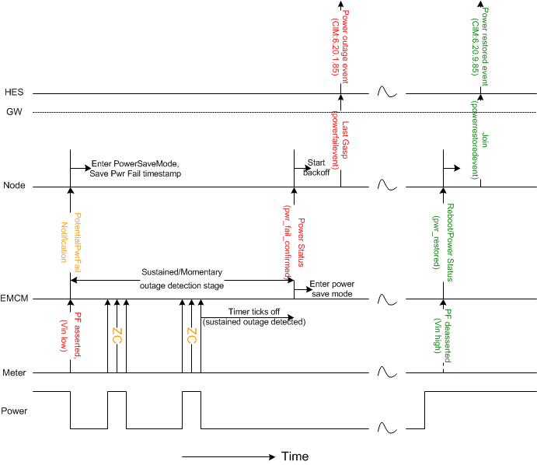
Power Fail Timeline
Power fail/power fail clear indication are sent by node for fast delivery
Can be leveraged by any application
Momentary vs sustained outage detection and triggering power fail events is done by EMCM

Slide 33
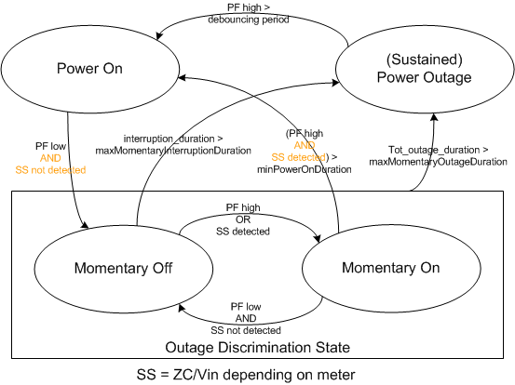
Momentary vs Sustained Outages
Three parameters:
maxMomentaryOutageDuration (default 2 min)
maxMomentaryInteruptionDuration (default 20 sec for I210+c/kV2c, 120 secs for SGMs)
minPowerOnDuration (default=3000msec)
Stored as EMCM config
Updateable via OTV (OTA message SetMeterCfg)

Slide 34
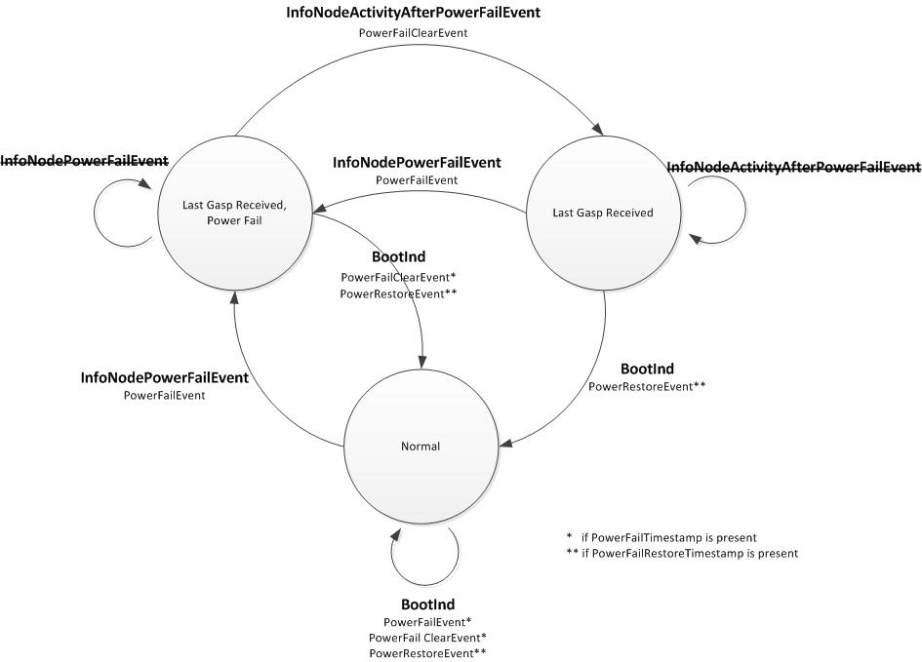
Power Fail Notifications: HES side
HES uses power fail information in BootInd to generate events in case LastGASP was lost
Use case: statistics

Slide 35
Message Transfer Protocol (MTP)
(uStream) : Reliable, message-based transport protocol with QoS Support

Slide 36
AMI 1.2 Message Format
Header indicates version
32-bit CRC that prevents against transmission/reassembly errors
Payload in AMI 1.2 is encoded using google protobuffers
IDL: ami_ota_inf.proto
Looks and feels like xml but compressed for transmission over wire
Encoded messages are then sent to MTP (Ustream) transport layer for transmission

Slide 37
MTP (uStream)
Windowing-transport protocol purpose built over RPMA MAC to provide end-to-end reliable delivery and flow control
Message based: Manages fragmentation and reassembly of messages (upto 7 Mbytes)
Built in QoS support: 16 streams (separate for UL/DL) with streamId=0 being highest priority and 15 being lowest
0, 14, 15 are reserved and used for uStream control: rest available to application
Well-defined API that can be integrated into application FW and SW
Integrated into host_cmn sw library for device-side
A standalone java implementation for network side integrated into HES
Provides reliability over both unicast and multicast downlink transports

Slide 38
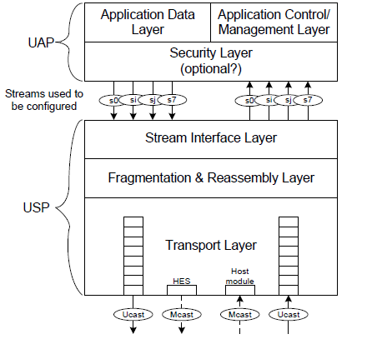
Protocol Stack and Buffer Management
Transport Buffer size=8 segments
Max size of each segment=464byes
USPBuf (EMCM side):
Common buffer management between application and uStream for transmit side
Cyclic buffer of size ~ 7680 bytes
Stream dependent data size reductions can be imposed
Can hold up to 16 messages (descriptors)
Network side:
MTP library holds upto 1 message/stream after transport buffer is full

Slide 39
QoS in AMI via MTP
UL non-resumable streams used: 3, 5, 7, 8
Highest priority stream 3 reserved for bootstrapping messages and responses to requests: Latency considerations
Stream 5 for billing data, 7 for other data, 8 for EMCM diagnostic data
Buffer and descriptor limitations imposed on lower priority streams to prevent lower priority data flood from starving higher priority data
DL non-resumable streams used: 3, 5
Bootstrapping messages (HES generated) on stream 3
Data messages on stream 5
Note: Non-resumability => queued data is lost on EMCM reboot

Slide 40
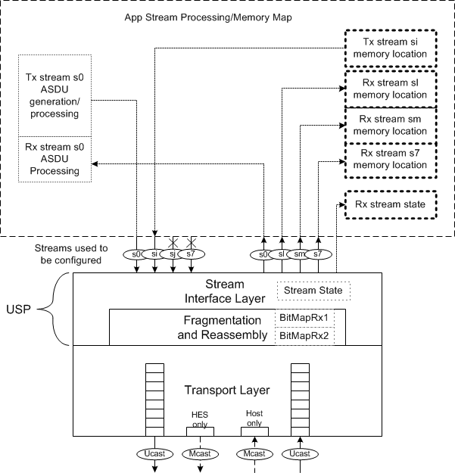
Resumability
Resumability => Reliable delivery across device reboots (power outage or otherwise)
Important for delivery of large messages
Streams can be marked resumable
Device Application SHALL provide persistent storage for resumable stream state as well as data
In EMCM
Resumable state is in external flash
Managed by Data Object Manager (DOM)

Slide 41
Resumable streams on AMI
Downlink (DL: HES → EMCM)
Meter Read/Program Update Request : DL Stream 10
OTA message: C1219Req
Maximum reserved space in external flash ~50kbytes
Lowest priority (doesn’t choke other UL messages)
Uplink (UL: EMCM → HES)
Meter Read/Program Update Response: UL Stream 10
OTA message: C1219Rsp
Maximum reserved space in external flash ~50kbytes
Lowest priority (doesn’t choke other UL messages)
Future uses: Meter FW upgrade, (EMCM FW upgrade)

Slide 42
Reliable Multicast
RPMA system provides multicast user data (MUD) channel for transport of DL data
Useful for transmitting same request to large number of devices
Group management is done by RPMA GW
MUD on RPMA network is best effort!
Ustream provides a wrapper that enables reliable multicast
Internally Ustream uses MUD channel, collects feedback and lost fragments are transmitted over reliable unicast
Greatly simplifies application development
Application has to create and manage MUD groups
Ustream API expect groupId and members of groups to be provided

Slide 43
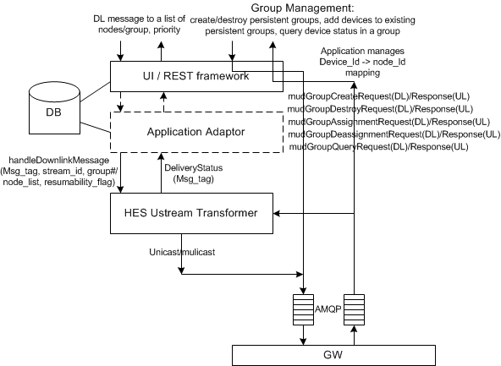
Reliable Multicast
Reliable multicast is used by AMI mainly for sending “Meter Program Update”

Slide 44
Meter Read/Program Update
C1219Req/C1219Rsp

Slide 45
C1219Req/Rsp
AMI protocol message that specifies sequential C12.18 (PSEM) operations to read/modify meter data stored in ANSI C12.19 data format in single C12.18 session
C12.18 Actions: READ/WRITE/PROCEDURE
EMCM Actions: PATCH/DELAY/(READ&COMPARE)
Number of retries can be specified (fixed in HES to 3)
C1219Rsp: Returns read data and result of operation
Various verbosity levels
Use cases:
Meter Program (Configuration) Update
Large table reads for debug/audit purposes

Slide 46
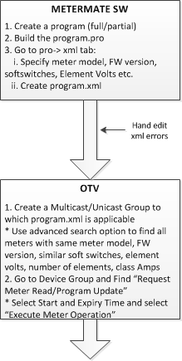
Program Update: Procedure
GenericSchema.xsd
Program.xml should validate against this schema
Features:
Compatibility check: Meter Model, FW version, ElementVolts etc
Programming: Set of instructions that programs the meter
Audit Check: Validate that changes took place
Note: This schema was basis of pro→xml conversion in MeterMate 6.4 and 6.5. Ingenu has tested program update only against MeterMate 6.4 generation
Alcara (formerly GE) has notified that recently released MeterMate 6.6 has new version of program.xml based on modified schema.
OTV 1.2 is not compatible with new schema
Feasible C1219Req as defined doesn’t need modification
HES: Program.xml → C1219Req for OTA tx

Slide 47
Some other tidbits…
C1219Req/Rsp are mapped to resumable streams
Stream 10 on DL (Req) and stream 10 on UL (Rsp)
Ustream protocol limits 1 message per resumable stream
Memory requirements otherwise are high!
This implies that when sending a C1219Req to a group, none of the devices should have a pending unacknowledged C1219Req
One member of the group can hold the entire group!
“Flush” terminates any unfinished messages on a stream and clean up states
Allows new requests to be enqueued
“Abort Meter Operation”→C1219AbortReq
Aborts execution of request and if done aborts tx of C1219Rsp

Slide 48
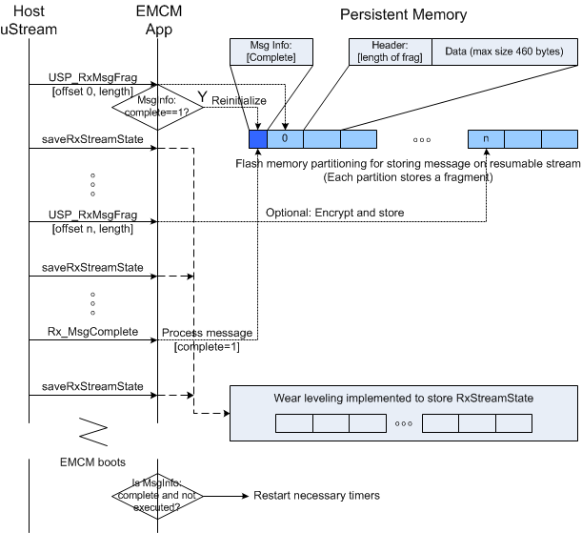
EMCM Processing of C1219Req Fragments

Slide 49
EMCM FW Update

Slide 50
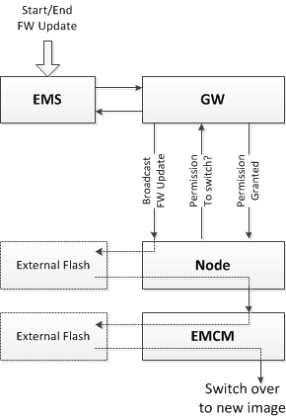
EMCM FW Update
Managed in AMI 1.2 via EMS
Same code download broadcast protocol that is used for RPMA node FW update
Reason: Have had years of test coverage and field use
Limited to < 250 kbytes download (RPMA node flash limitation)
Transferred to EMCM’s external flash for staging: Managed by DOM (data object manager)

Slide 51
BACK UP

Slide 52
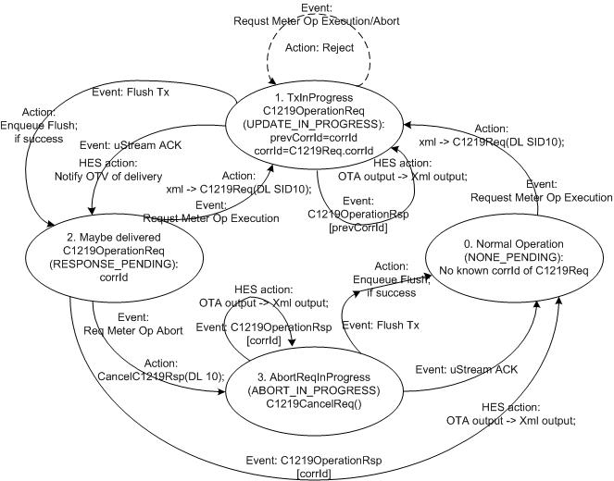
MPU: HES state transitions

Slide 53
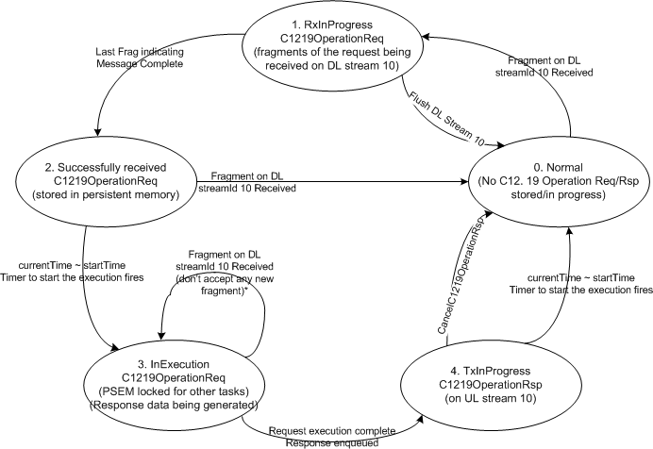
MPU: EMCM State Transitions

Slide 54
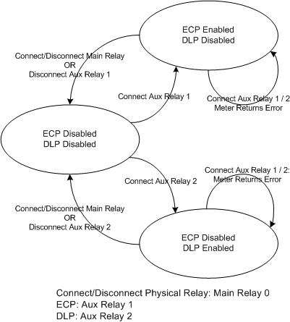
I210+c ECP/DLP state transition (relevant for Haseko)

Slide 55
Outstanding Areas of Concern
HES/EMCM/Meter

Slide 56
Program Update: Known Issues I
Program.xml generated by MeterMate 6.4 (and for partly tested 6.5) is insufficient and have lot of errors
Insufficient as there is no way to compare bitfields (< 8 bits)
Work around: Remove from Compatibility test (Element Volts)
Remove ElementVolts, no softswitch check etc: should be managed via OTV group creation feature so that invalid program doesn’t reach a meter
Errors
Work around: Ingenu maintains a list (MM 6.4 only!) and hand edits program.xml
Alcara has introduced new errors in program.xml generation in MM 6.5
Meter program clears all meter data
Work around:
Remove SP3 (clear meter data procedure) from program.xml (occurs twice)
Ensure that ST12-15 writes are removed and instead

Slide 57
Program Update: Known Issues II
SGM3000 full program update with clear meter data doesn’t work: Not supported
SGM reboots and breaks C12.18 session in the meter
C1219Req is designed for update within single C12.18 session
Work around:
Most field scenarios require no clearing of meter data.
Thankfully removing SP3 makes it work!
C12.18 negotiation is not followed on I210+c
EMCM restarts C12.18 session with parameters acceptable to I210+c

Slide 58
Other Issues I
Many areas are covered in “Product Requirements Document” for AMI 1.3 and OTV 1.3
HES Horizontal Scalability
Known Ustream issues
Rare: May happen if mySQL updates are lost: Ustream may get stuck if states are out of sync
Short term fix: Force Ustream SYNC when detected
Ustream provides an API to force SYNC: Not exists on OTV UI yet.
Have been fixed and tested: not ported to released EMCM
Back-to-back DL requests (arriving simultaneously at EMCM) may get overwritten

Slide 59
Other Issues II
Load Profile data may get time shifted by an hour around DST for the LP block since end block reading timestamp changes
Note: Separate issue exists with SGM3000 meters: With LP outage recovery enabled and meters without battery causes SGM meters to incorrect report the time associated with reading

